Slide 1

A Case for Adobe InDesign as Tech Writing Tool
Who knew?
FINAL PROJECT—Rebecca K. Lewis

Slide 2
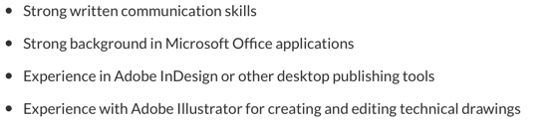

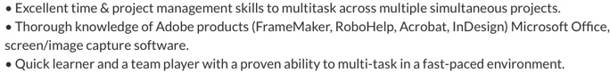
Why
???
Look at these
TECH WRITING JOB ADS!

Slide 3


But FIRST…Why FrameMaker?
Industry Standard since the 1990s.
Tech Writing Software.
Apparently user friendly??
Can import from other doc types.

Slide 4
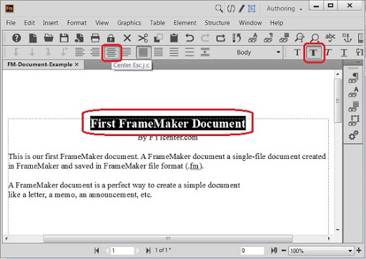
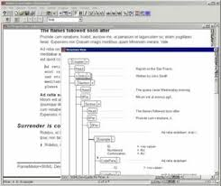
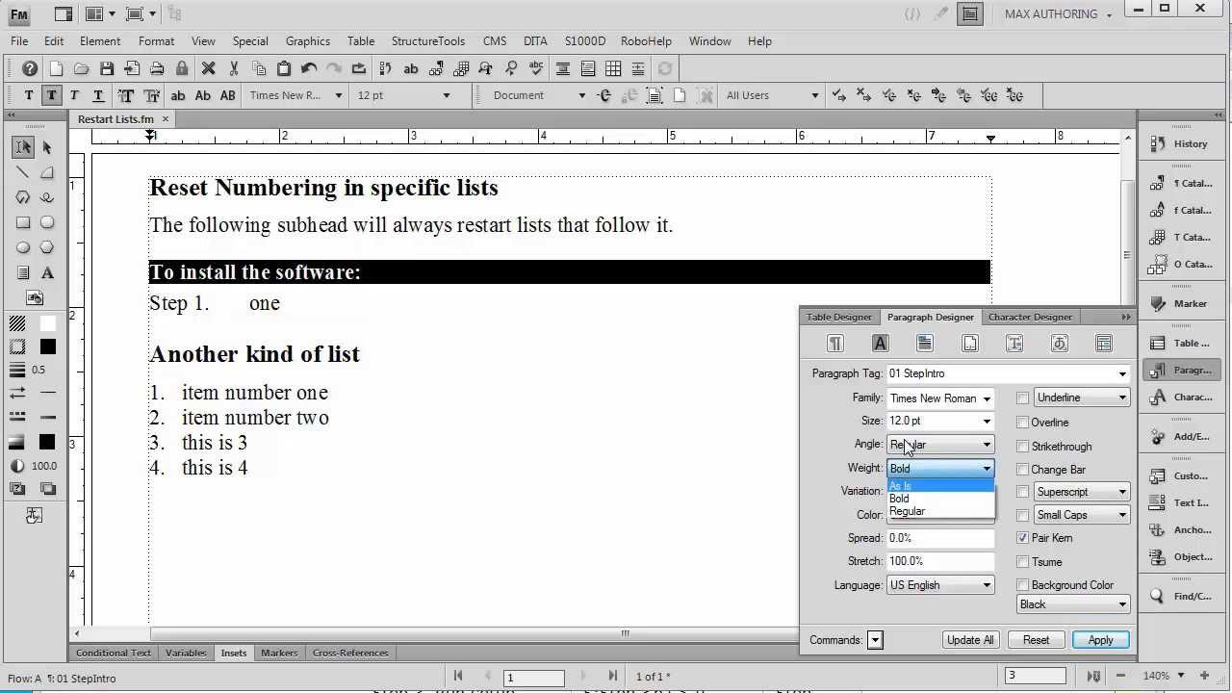

But What About This?
Not visually appealing. Very dated-looking interface for an “updated” software. Can be a little clunky.

Slide 5
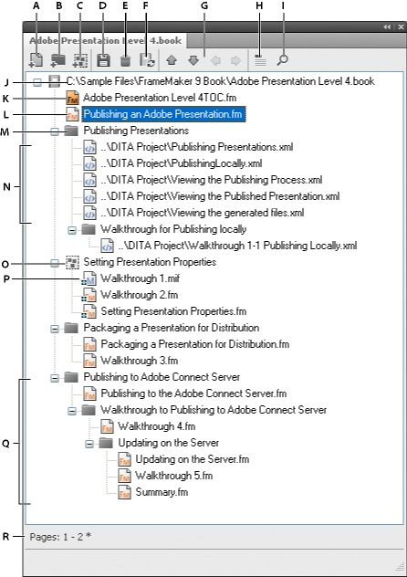
Also this!
FrameMaker Book File interface does not look like a book to me, a visual learner.
Is there a different way to view this?

Slide 6

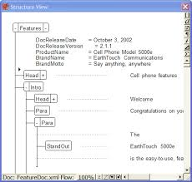


And don’t FORGET!
Writing in XML is daunting to some tech writers (NO WAY!!)

Slide 7

Ok, now for InDesign… WARNING: I do not know everything about it!
A learning curve, especially for those unfamiliar with Adobe products. I had no training on it.
Not “tech writing software,” necessarily.
But why not? Too visual?
Short docs only?
Can you import/export different kinds of documents?

Slide 8
THINGS YOU CAN CREATE WITH ADOBE INDESIGN:
Magazine articles
Brochures
Menus
Textbooks
Manuscripts (up to 9,999 pages!)
Templates for many more ideas!

Slide 9

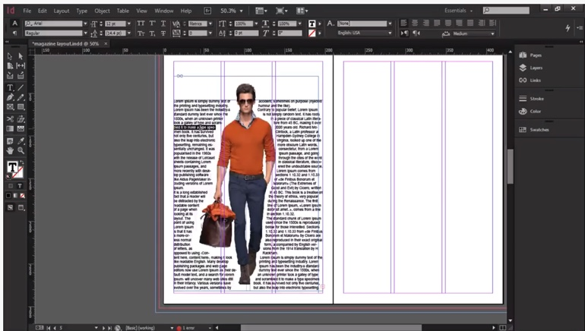
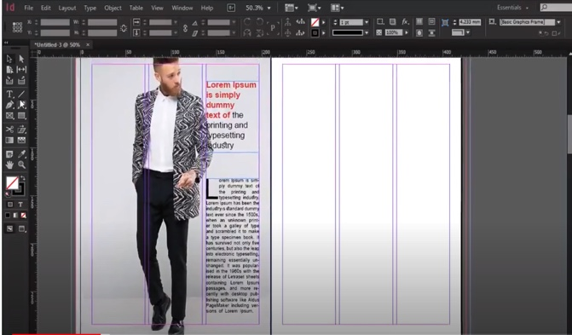
Magazines:

Slide 10
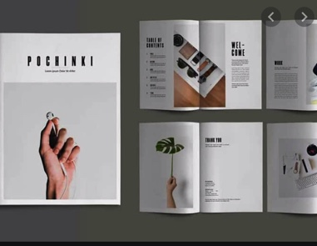

Other things:
Brochures!

Slide 11
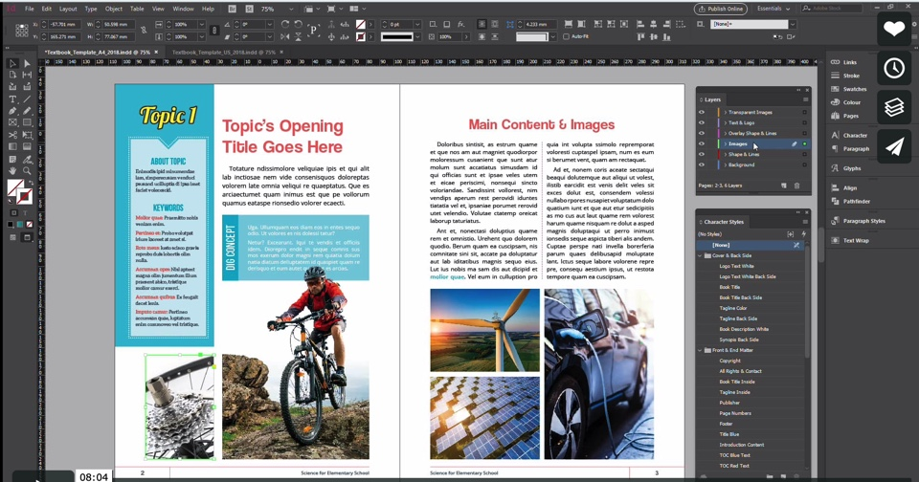



Textbooks, User Guides, and Manuscripts-OH MY!

Slide 12
What you can IMPORT into InDesign:
Word Files (using “placing”)
PDFs (ditto, but doesn’t allow editing without a third-party plug-in)
XML files
HTML, yes-but indirectly-must use XML format
Jpg and png files (best suited!)

Slide 13
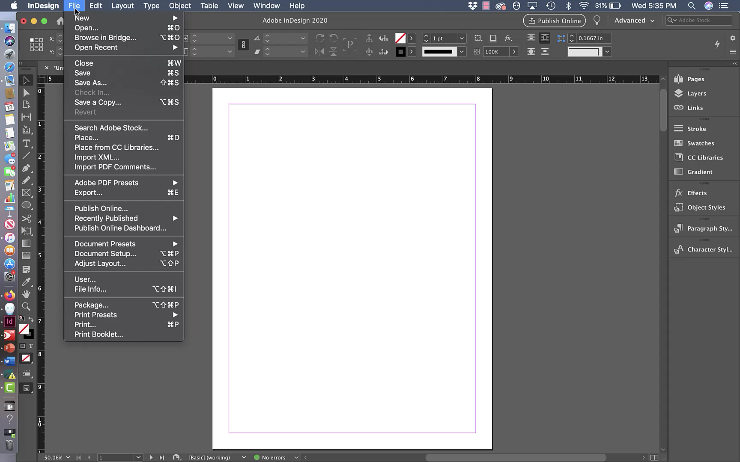
What can you EXPORT using InDesign?
EXPORT OPTIONS:
Adobe PDF, EPUBs, HTML, InDesign Markup, JPEGs, PNGs, XMLs

Slide 14

How to Create a BookFile in InDesign:

Slide 15
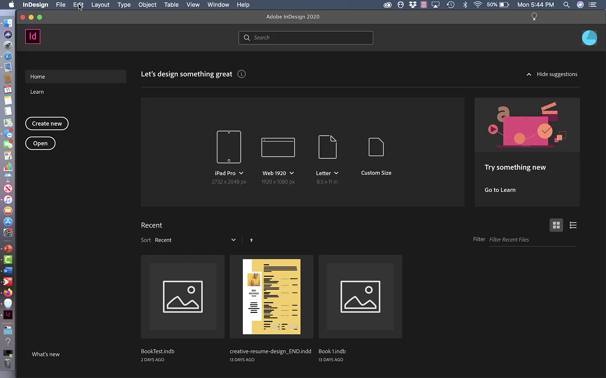

Slide 16
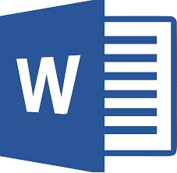
How to “EXPORT” a Microsoft File to InDesign using “Placing.”

Slide 17
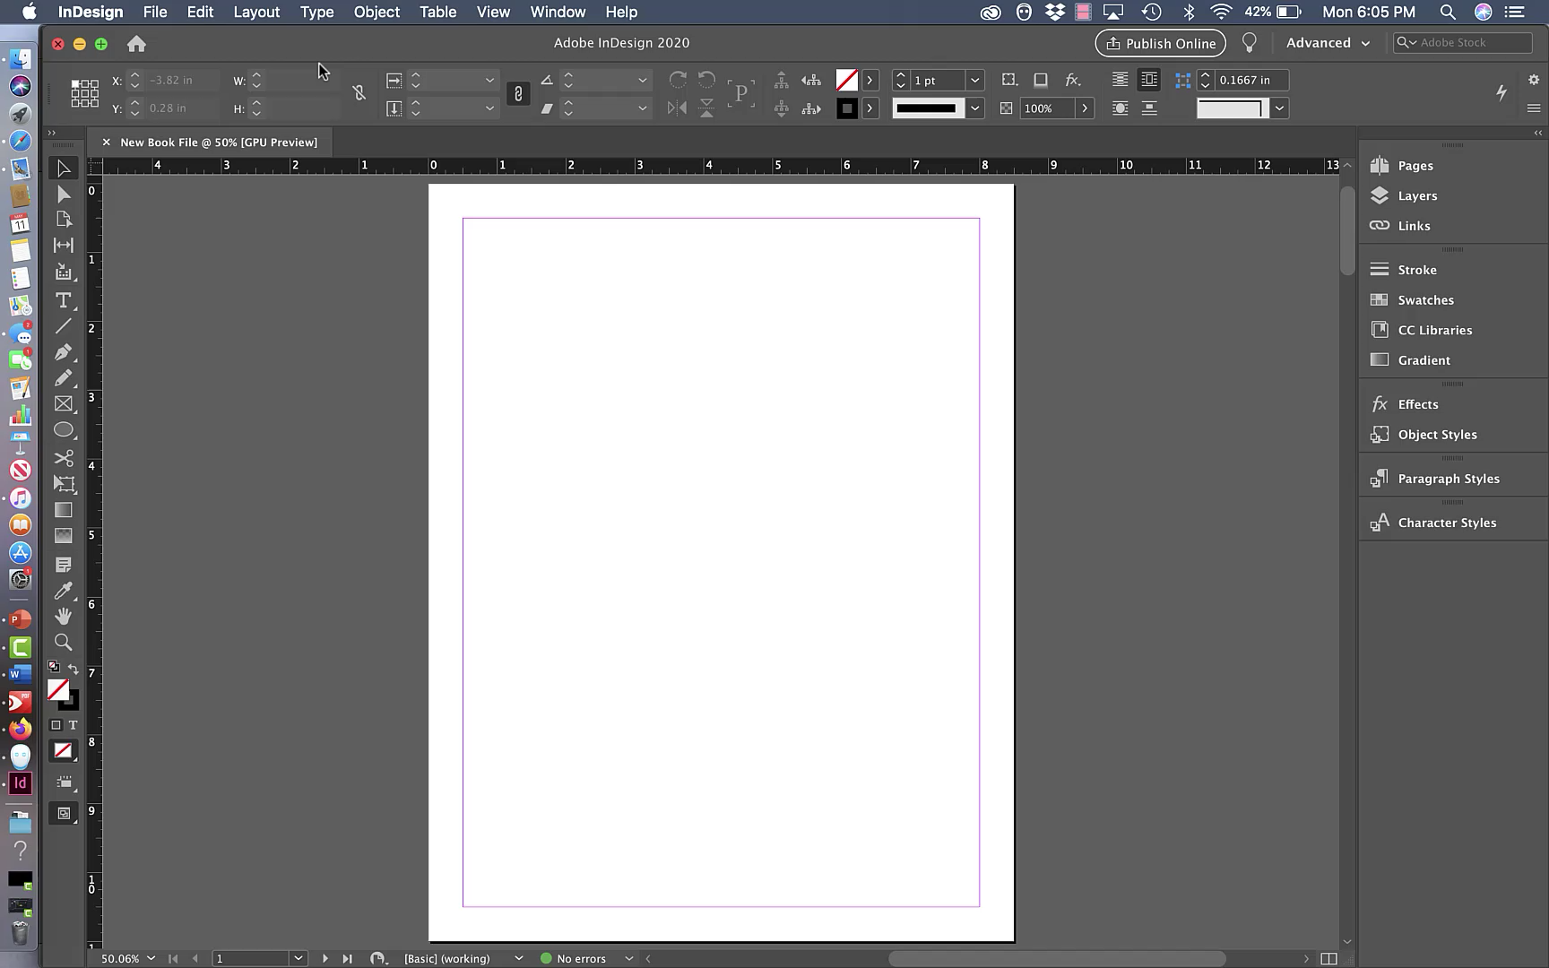

Slide 18

How to Insert a Picture in InDesign using “Placing."

Slide 19
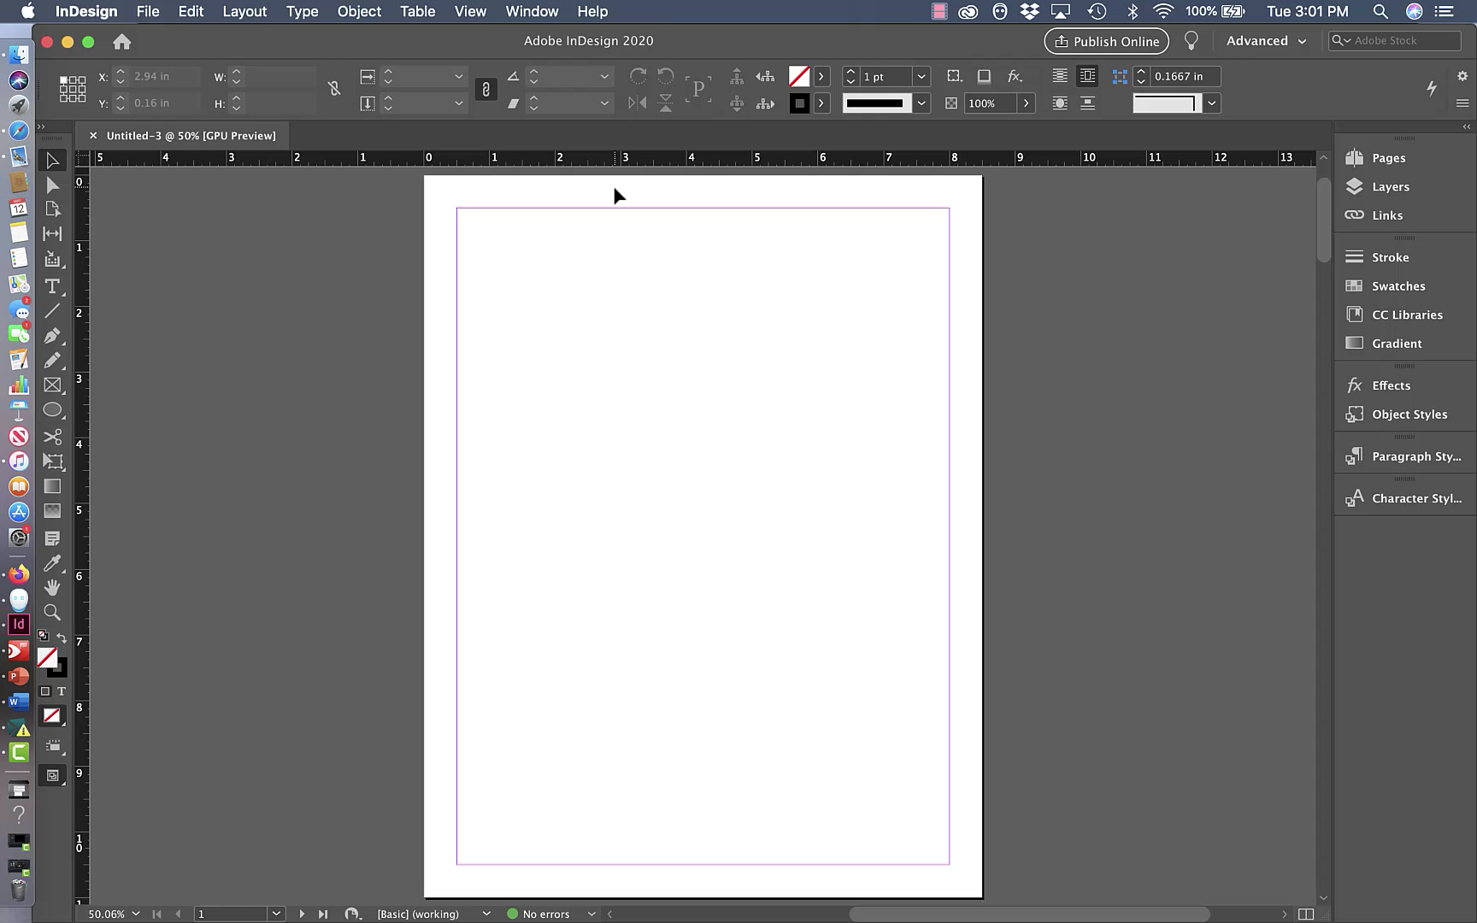

Slide 20
Why add InDesign to course toolkit?
Good for visual learners and artistic/creative types.
Cost effective! Students get the whole Adobe CC for $19 a month! If InDesign can’t do it, another app in the Creative Cloud certainly can!
FrameMaker stands alone!
Good for folks who don’t think in terms of XML or HTML
So many things it can do!!
JOB ADS!!!

Slide 21
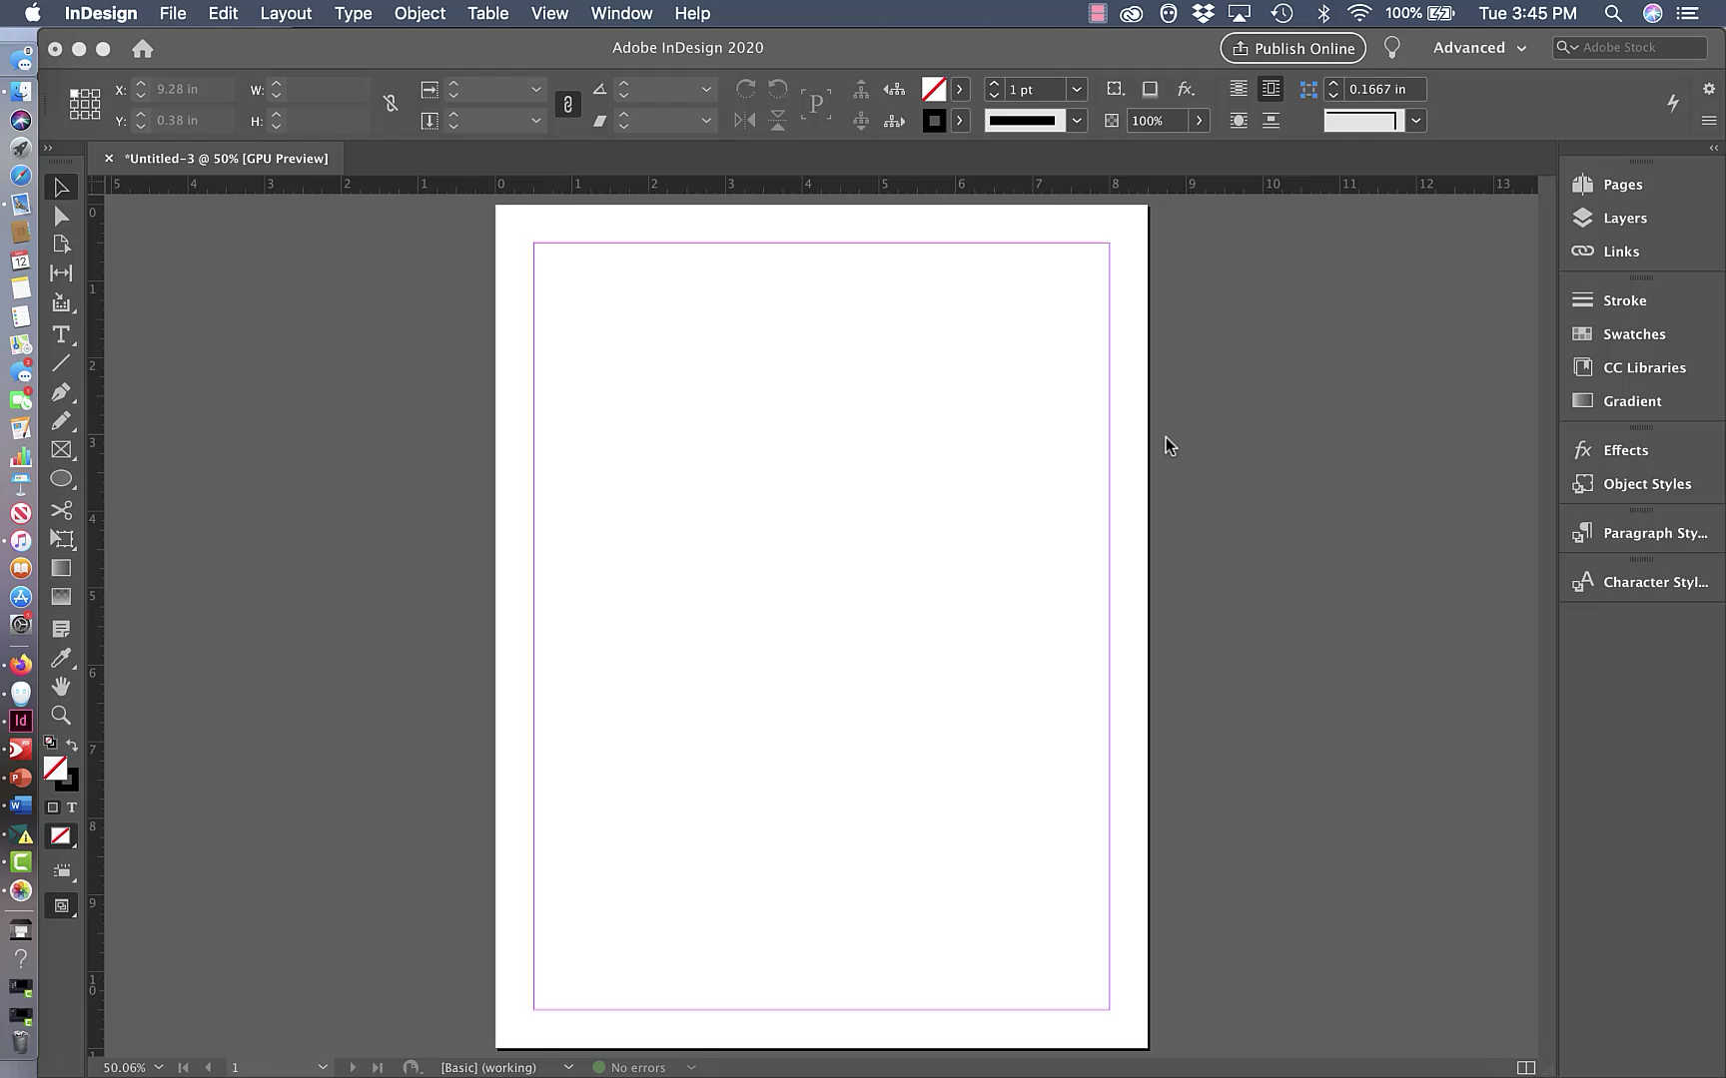

Resources everywhere!
Because of its popularity, tutorials can be found everywhere!
Under the lightbulb icon.
YouTube videos.
Web tutorials
PDF guides

Slide 22
ANY QUESTIONS OR COMMENTS?
DID I MISS ANYTHING?

